Slide 1
IBM Analytics Engine

Slide 2

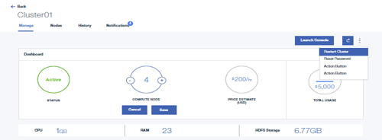






IBM Analytics Engine
IBM Analytics Engine is built on open source Apache Hadoop and Apache Spark – Hortonworks Data Platform. It provides users flexibility of open source and an opportunity to expand on existing open source investments
IBM Analytics Engine provides Data scientists, Data engineers, and Developers appropriate interfaces to build data models and business solutions while simplifying cluster administration through easy to use interfaces for management and integration
IBM Analytics Engine deploys clusters in minutes with enterprise grade security, reliability, and integration with other IBM Cloud offerings

Slide 3
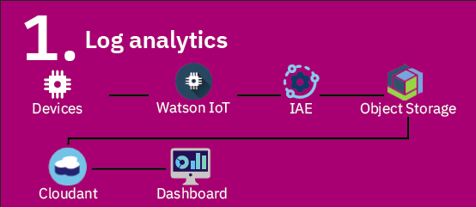
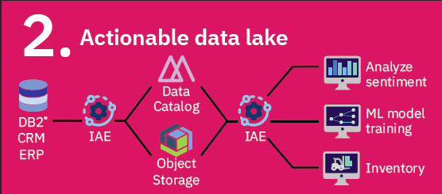
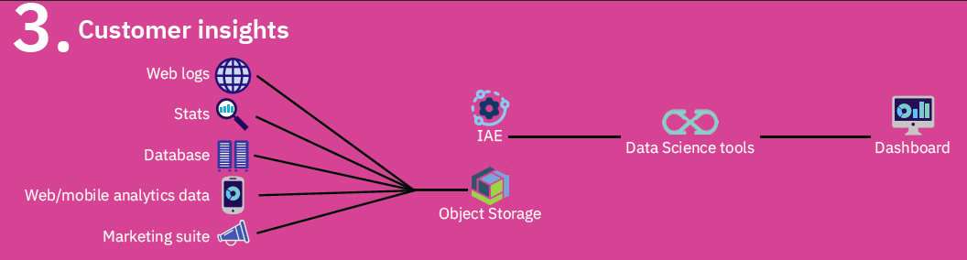
Use case patterns

Slide 4
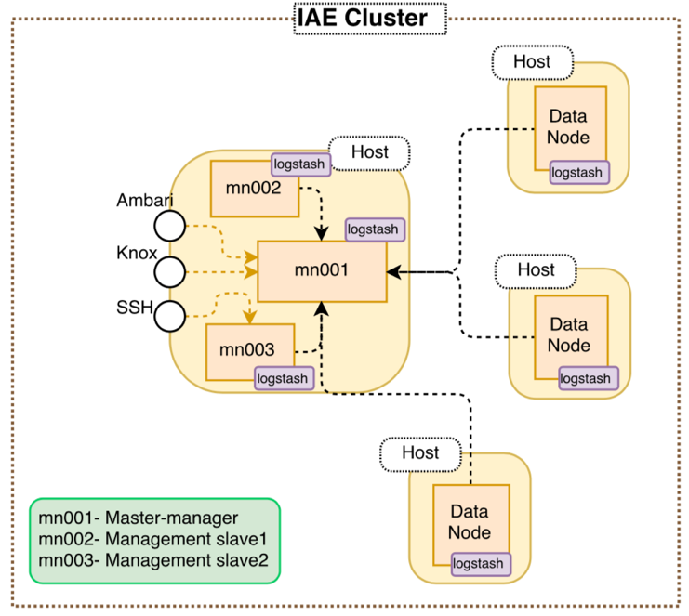
The Cluster
Notes:
Management nodes
Master manager
Pre-requisite services: LDAP, Mariadb, Ambari server, sssd, Ambari Agent
Knox
Management slave1- management daemons
Pre-requisite services- Ambari Agent, sssd, sshd
HDFS(NameNode, Yarn(ResourceManager), Hive(Hiveserver2), Spark(History), Hbase (Hbase Master)
Management slave2- management daemons
Pre-requisite services- Ambari Agent, sssd, sshd
JKG(jupyter enterprise gateway), Spark Thrift server
Data nodes
Pre-requisite services- Ambari Agent, sssd, sshd
HDFS(Datanode), Yarn(Nodemanager), Hbase(Hbase Region server)

Slide 5

create
cf / bx CLI or REST API
create
create
Analytics Engine Service
USER
Console UI
Resize / customize
Analytics Engine
REST API
Resize / customize

Slide 6
Working with Spark
Spark Jobs
Batch - Fire and Forget
Spark-Submit
Livy
AE CLI
Interactive - Execute code and see results for each line
PySpark
SparkScala
SparkR
JNBG (Jupyter Notebook Gateway)
Spark Jobs
From within the cluster
From outside
Note1 : Default number of executors for Spark is 2. You can change it in spark configuration to suit your workload
Note2: Spark uses stocator – a better performing library for writes and reads

Slide 7
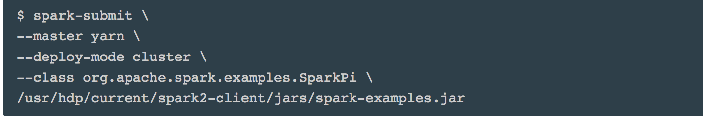
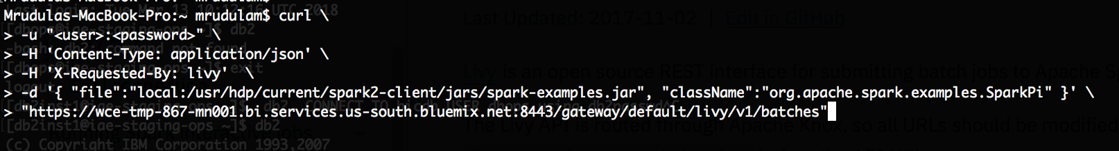
Batch Spark Jobs
Spark-Submit (from the cluster)
The spark CLI on the cluster
Livy (from anywhere)
REST API for submitting Spark jobs

Slide 8
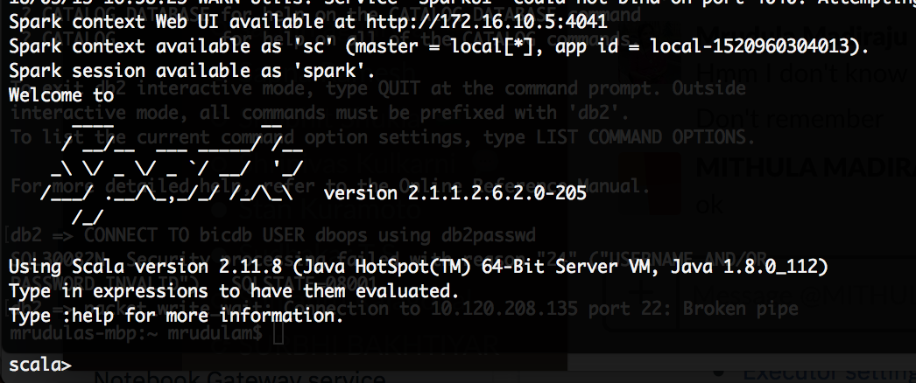
Interactive Jobs – Launching scala shell
Launching the spark scala shell

Slide 9
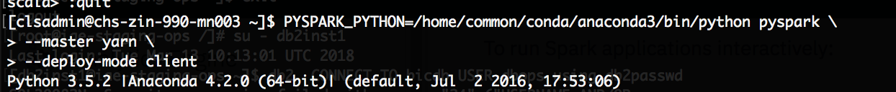
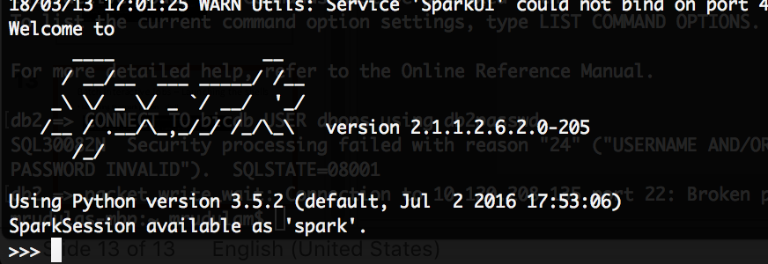
Interactive Jobs – pyspark
Launching the spark python shell

Slide 10
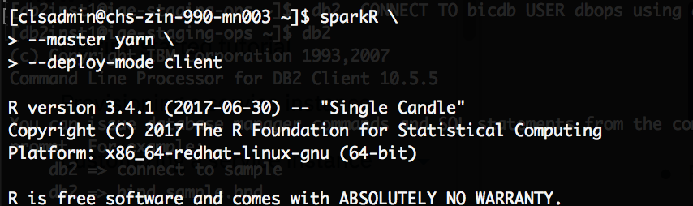
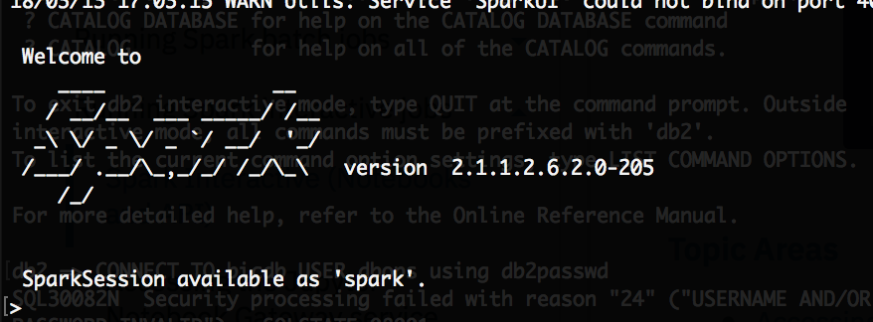
Interactive Jobs – SparkR
Launching the spark R shell

Slide 11
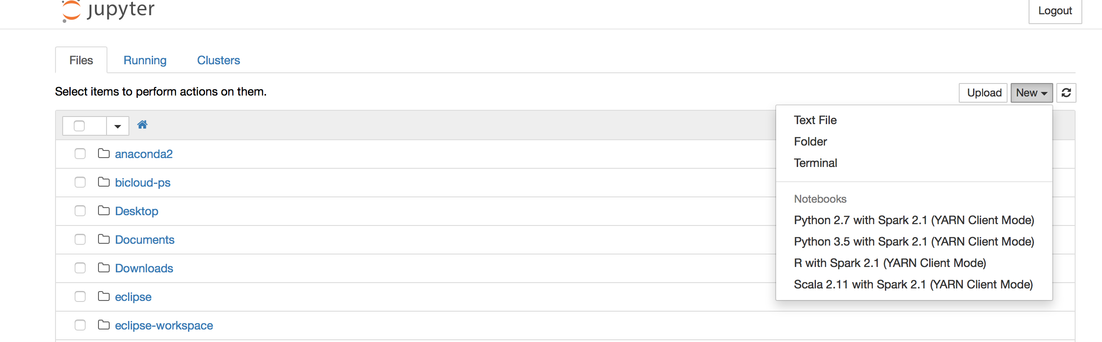
Interactive – JNBG – working with IAE cluster

Slide 12
Interactive – JNBG – Sample python program

Slide 13
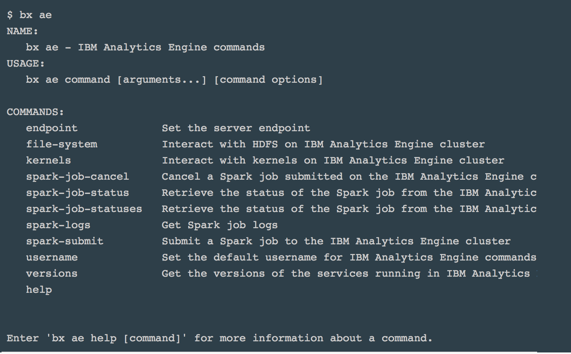
Analytics Engine - CLI

